Slide 1
Domestic violence 2022 update

Slide 2
Domestic Violence update training
Completed every 2 years per 13519 PC- mandated for all law enforcement below the rank of supervisor assigned to patrol duties and would normally respond to domestic violence calls
After viewing the PowerPoint, you must notify Heather Hutchinson that you have completed training to be signed off.

Slide 3
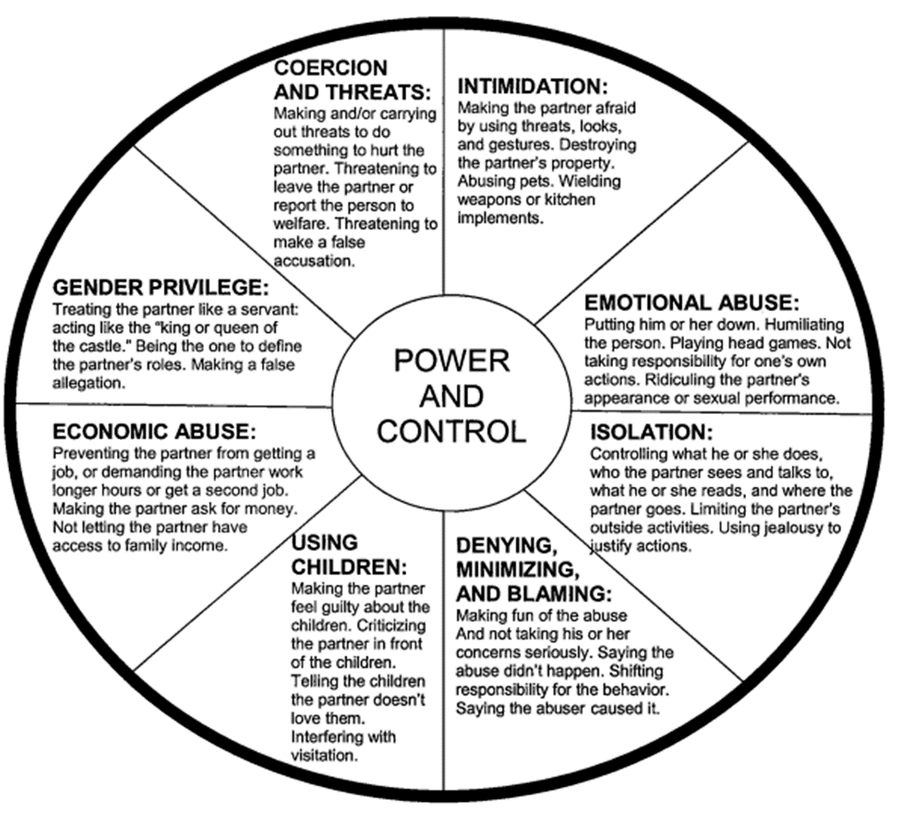
Who is at risk for Domestic Violence?
ANYONE - DV spans the entire socioeconomic scope
Any race, sexual orientation, age group, etc.
Common DV triggers:
Money
Children
Infidelity
Substance Abuse
Mental Illness
Learned Behavior

Slide 4
Domestic Violence and children exposed to domestic violence Law Enforcement protocol
San Diego County – Updated 2019
1990 – FIRST COUNTY-WIDE DV PROTOCOL ENDORSED
Promote Victim Safety
Protect Children Exposed
Abuser Accountability
Regional coordinated response

Slide 5
Domestic violence defined (13700 PC)
Abuse committed against an adult or a minor who is a
Spouse or former spouse
Cohabitant or former cohabitant
Person with whom the suspect has had or is having a child
Is having or has had a dating or engagement relationship.
“Abuse” - intentionally or recklessly causing or attempting to cause bodily injury or placing another person in reasonable apprehension of imminent serious bodily injury to himself or herself, or another.

Slide 6
Cohabitant
Two unrelated adult persons living together for a substantial period, resulting in some permanency of relationship. Factors that may determine whether persons are cohabiting include, but are not limited to,
(1) sexual relations between the parties while sharing the same living quarters,
(2) sharing of income or expenses,
(3) joint use or ownership of property,
(4) whether the parties hold themselves out as spouses,
(5) the continuity of the relationship, and
(6) the length of the relationship.

Slide 7
Officer Response to DV Calls
Respond in a proper and timely manner
Always take a cover unit
Upon arrival at the scene, Officers shall
Evaluate the situation,
Stabilize the situation and protect the safety of all parties involved at the domestic violence scene, including that of the Officer.
Obtain pertinent information from
Victim
Witnesses, including children present
Suspects
Reporting Party – Opportunity for additional corroboration

Slide 8
Determine location and condition of victim(s) including children.
Determine if suspect is still at scene.
Determine if any weapon is involved.
Summon ambulance if injuries require medical attention.
Separate the victim, suspect and witnesses.
Prevent communication between the parties, including out of hearing range. Re-ask about weapons once the parties are separated.
Determine what, if any, crime has occurred.
If a sexual assault is reported, determine the need for an evidentiary exam and determine if area detectives need to be contacted.
If strangulation has occurred, ask if victim is willing to participate in a Domestic Assault Forensic Exam (DAFE)

Slide 9
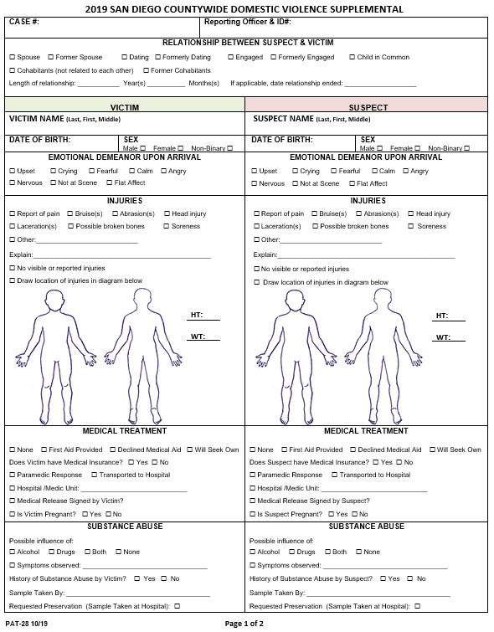
Victim Interview
Document the victim’s physical condition
Injuries? – Evaluate for the need of ambulatory care, describe in detail, photograph
Has the victim been strangled?
Document signs and symptoms of Strangulation COMPLETE STRANGULATION SUPPLEMENTAL (PAT-31)
Document V’s emotional condition and demeanor
Determine V’s relationship to suspect – Request any photo of victim and suspect together
Note statements made by suspect to victims during incident
Document prior DV and in detail
Ask if victim has notified anyone of current incident or previous incidents. Document who with contact information.
Complete the DOMESTIC VIOLENCE SUPPLEMENTAL (PAT-28) on all crime/arrest reports of DV

Slide 10
Victim Interview
Provide information on obtaining a gun violence restraining order and a protective order described in Section 6218 of the Family Code.
At no time shall the Officer advise any victim of domestic violence that they can "press" or "drop" charges.
Officers shall inform both the victim and suspect that once a crime report is taken, the decision to prosecute rests with the City or District Attorney, regardless of the wishes of the victim or the presence or absence of the suspect or personal beliefs of the deputy as to whether or not the case will be prosecuted
UPDATE –
A VERBAL REVIEW OF THE RESOURCES AVAILABLE FOR VICTIMS OUTLINED ON THE WRITTEN NOTICE PROVIDED PURSUANT TO PARAGRAPH (9) OF SUBDIVISION (C) OF SECTION 13701.
If reasonable grounds exist to believe the person is in immediate and present danger, the person will be advised of the availability of the emergency protective order.
The Officer does not need the permission or request of the victim to seek an emergency protective order.

Slide 11
Emergency Protective Orders
Emergency protective orders may be issued verbally by telephone or otherwise on a 24 hours a day, 7 days a week basis.
The judge may issue an ex-parte emergency protective order when an Officer asserts reasonable grounds to believe that a person is in immediate and present danger of domestic violence, based on the person’s allegation of a recent incident of abuse or threat of abuse by the person against whom the order is sought. [Family Code Section 6250(a)]
Mon-Fri 0800-1700 hours - Contact a Judge at Family Court at 619-844-2942.
After court hours, weekends or holidays – Contact San Diego Sheriff’s Warrant Office at 858-974- 2493 to contact on duty judge.
Both are non-public numbers.

Slide 12
Suspect Interview
Describe suspects location on arrival. If not on scene, attempt to locate subject. Obtain contact information
Describe Physical and Emotional condition. Document, describe and photograph any injuries or lack of injuries.
Document evidence of illicit drug use, prescription drug and alcohol use by the suspect, conduct examination, obtain blood/fluid sample, and add charge if appropriate.
Inquire about mental health history, diagnoses, suicidal ideation, and medications.
Admonish as necessary
Consider requesting a bail enhancement in situations where the amount listed in the bail schedule is insufficient to ensure the victim's safety.

Slide 13
Dominant Aggressor
Officers shall make reasonable efforts to identify the dominant aggressor in any incident. The dominant aggressor is the person determined to be the most significant, rather than the first aggressor [Penal Code section 13701(b)].
In identifying the dominant aggressor, the Officer shall consider the following:
The intent of the law to protect DV victims,
Any threats – real or implied – which instill fear of physical violence by one partner toward another,
Any history of domestic violence between the persons involved,
Any history of controlling behavior or coercion,
If either partner acted in self-defense

Slide 14
Dominant Aggressor: Other factors to consider
Height/weight of the parties
Criminal history
Level of violence
Presence of fear
Existing court orders
Corroborating witnesses
Demeanor of parties
Use of alcohol/drugs
Offensive/defensive injuries (are the injuries consistent with explanation?)
Who was the 911 reporting party?

Slide 15
When to arrest
FELONY ARRESTS:
If an Officer has probable cause to believe that a DV felony has occurred, an arrest shall be made, absent unusual circumstances.
MISDEMEANOR ARRESTS
in Officer's presence:
If there is probable cause to believe that a DV misdemeanor offense has been committed in the Officer’s presence, an arrest shall be made.
The Carlsbad Police Department implements a pro-arrest policy encouraging Officers to arrest domestic violence offenders if there is probable cause that a domestic violence offense has been committed

Slide 16
When to arrest
Misdemeanor DV committed outside a Officer's presence:
A Officer may arrest without a warrant where both of the following circumstances apply:
a. The Officer has probable cause to believe that the person to be arrested has committed the assault or battery, whether or not it has in fact been committed;
and
b. The Officer makes the arrest as soon as probable cause arises to believe that the person to be arrested has committed the assault or battery, whether or not it has in fact been committed [Penal Code section 836(d)].

Slide 17
When To arrest
Cite and release
Dual arrests
Citizen's arrest
Per 836(b)PC:
Citing and releasing a domestic violence suspect is discouraged because of our County’s philosophy that domestic violence is a criminal violation that should be treated as a safety issue for victims and for the community.
are discouraged but are not prohibited. Dual arrests should be the extreme exception and should only be utilized as a last resort when all other investigative efforts fail.
Any time a peace officer is called out on a domestic violence call, the officer shall make a good faith effort to inform the victim of their right to make a citizen's arrest unless the peace officer makes an arrest for Penal Code section 243(e)(1) or 273.5.

Slide 18
Witness interviews
Interview all witnesses separately and record names, addresses, email addresses, phone numbers and emergency contacts.
Interview neighbors (ear-witnesses).
Record names and addresses of emergency personnel responding (EMS/FD etc.).
Determine from witnesses if they are aware of a history of abuse or if they are aware of any illicit drug use, prescription drug and alcohol use.

Slide 19
If Children are present
Conduct a Minimal Facts Interview
Cross report to Child Welfare Services.
Consider an additional charge of 273a(b) PC Misdemeanor Child Endangerment if
Children are in the home or location at the time of the incident.
Children can be considered victims under this section when a person willfully causes or permits a child to be placed in a situation where his or her person or health may be endangered.
Consider an additional charge of 273a(a) PC Felony Child Abuse if the child is physically injured during the incident.

Slide 20
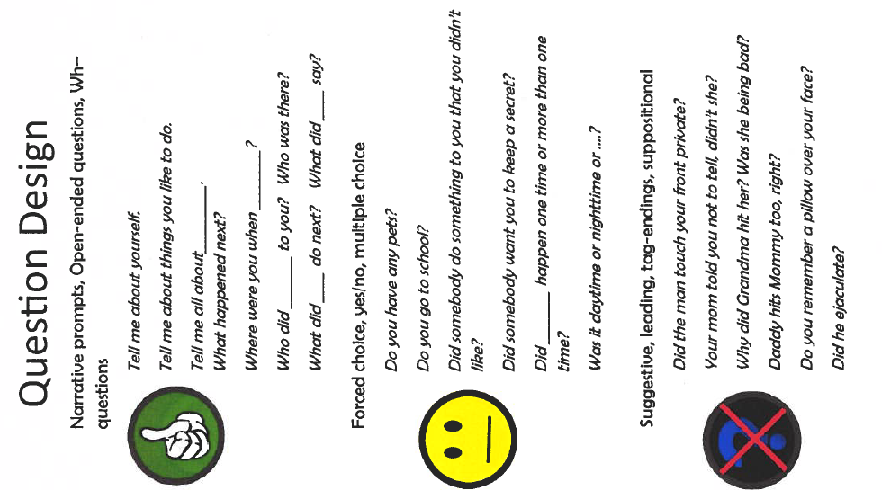
Minimal Facts Interview
NEVER BELIEVE CHILDREN ARE ASLEEP!
ALWAYS CHECK ON AND INTERVIEW CHILDREN – Corroboration
Interview separately from witnesses and parents
Slow down and build rapport
Open ended questions
Don’t introduce new information, use their words
Safety of the child
Do not ask questions related to time or sequencing events.
Do not react to child's statements that may minimize, shame or blame the child.
Do not ask leading or suggestive questions

Slide 21
DV Effects on children
High Correlation that children exposed to DV are later involved in DV relationships as victims or abusers
Stress the importance of victims receiving services for family members
Offer Forensic Witness Interviews to victims with children

Slide 22
Corroboration considerations
Statements from Victim, Suspect, Children and Witnesses
Forensic Interviews of Children
Weapons
Injuries
Medical Reports, DAFE Examinations, Medical Personnel
Body Worn Camera Recordings
9-1-1 Call Recording
Surveillance Videos
Crime Scene Photographs
Phone Records
Social Media Records
Prior Domestic Violence Convictions and / or Acts [Evidence Code 1109]

Slide 23
Strangulation
Has the victim been strangled?
Document signs and symptoms of Strangulation COMPLETE STRANGULATION SUPPLEMENTAL (PAT-31)
Redness/bruising/scratches to neck,
Raspy voice,
Soreness of neck,
Incontinence,
Petechiae (red dots) anywhere on the face, or in the eye,
Difficulty swallowing,
Difficulty breathing,
Coughing/vomiting,
Ability to recall history,
Torn clothing,
Smeared makeup.
Defensive wounds

Slide 24
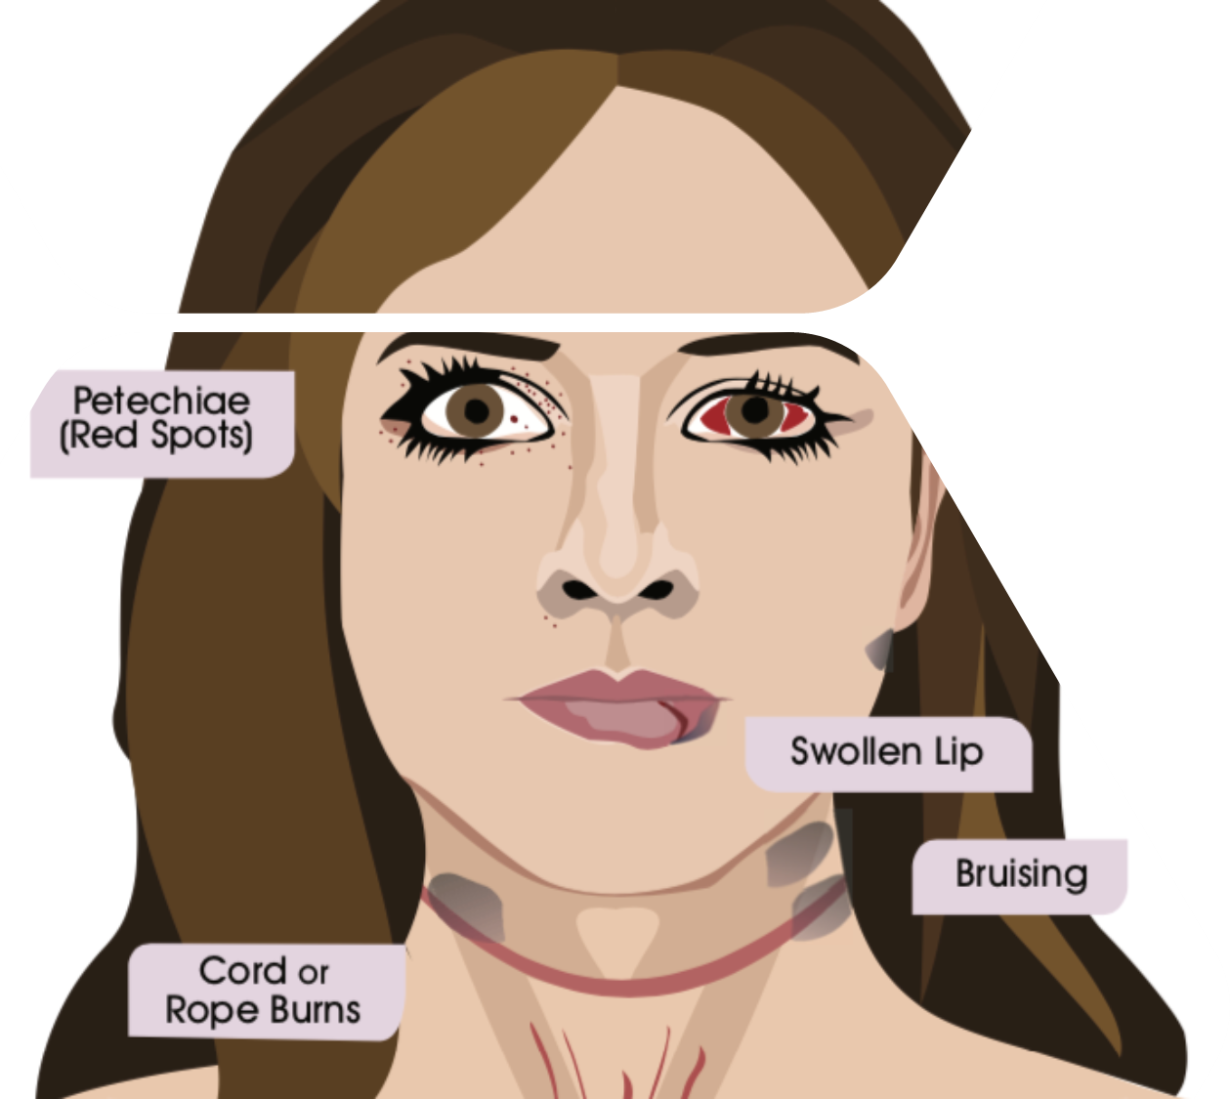
Ask victim what they were thinking while being strangled?
Did they lose consciousness?
Details leading up to incident and after the incident?
Describe what the victim saw (spots, blackness, flashing lights, etc)
Have the victim describe if they saw their abuser’s face and demeanor.
Did the abuser say anything?
Has the victim been strangled before?
What object was used to strangle (hands, rope, knee on neck, pillow, etc.)
Could the victim speak?
Offer victim forensic health services Domestic Abuse Forensic Exam (DAFE) through Palomar Health Forensic Services at
1(888) 211-6347.
Can be completed at
380 South Melrose Suite 408 Vista.
Palomar Forensic Health Office
Family Justice Center San Marcos

Slide 25
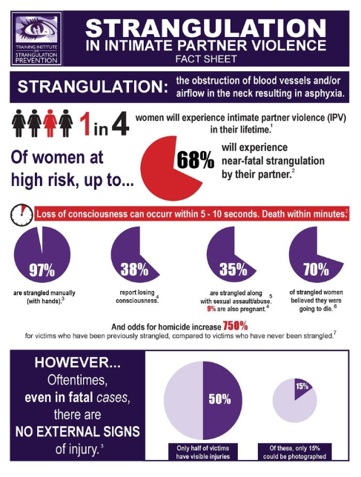
Strangulation
Look for injuries behind the ears, all around the neck, under the chin and jaw, eyelids, shoulders and chest area
Photograph and collect as evidence any object used for strangulation. Document if the suspect brought it to the scene (may show premeditation)
A victim of non-fatal strangulation, is 750% more likely to be murdered by their abusers.
Subjects who strangle are more likely to be combative with law enforcement and there is a correlation between these subjects and active shooters.

Slide 26
Weapons
An Officer at the scene of a domestic violence incident involving a threat to human life or a physical assault shall take temporary custody of any firearm or other deadly weapon in plain sight or discovered pursuant to a consensual search (pursuant to 18250(a) P.C.).
LE shall make every attempt to legally seize firearms or deadly weapons from DV incidents
If protective order is in place, LE shall take firearms into custody
A warrant may be needed if no consent and not in plain site

Slide 27
Who can obtain a GVRO?
18170 PC- Any of the following individuals may request that a court, after notice and a hearing, issue a gun violence restraining order enjoining the subject of the petition from having in their custody or control, owning, purchasing, possessing, or receiving a firearm or ammunition for a period of time between one to five years:
An immediate family member
An employer
A coworker
An employee or teacher of a secondary or postsecondary school that the subject has attended in the last six months
A law enforcement officer.

Slide 28
court order violations
An Officer responding to a violation of a domestic violence court order and the deputy has probable cause to believe that the restrained party has committed an act in violation of the order, the Officer shall arrest the person without a warrant and take that person into custody whether or not the violation occurred in the presence of the arresting Officer [Penal Code Section 836(c)(1), Penal Code Section 13701(b)].
The terms and conditions of the protective order remain enforceable, notwithstanding the acts of the parties and may only be changed by order of the court. The burden is on the restrained party to comply with the court order regardless of the protected parties' actions.
An emergency protective order shall have precedence in enforcement over the provisions of any other restraining or protective order.
Always check with Carlsbad Police Dispatch that a restraining order if served and valid!

Slide 29
Court order violation charges
273.6(a) PC
Domestic Violence Restraining Order
Temporary Restraining Order
166(c)(1) PC
Criminal Protective Orders issued by the court at the completion of or pending a criminal proceeding.

Slide 30
Evidence collection
Describe the crime scene, noting signs indicating struggle such as:
Overturned furniture, debris, destruction of property, hair that has been pulled out, Blood, Broken fingernails
Holes in walls
Damaged telephones, etc.
Photograph crime scene Obtain photo of victim and suspect to assist identifying relationship from victim
Determine if firearms or other deadly weapons are present and seize pursuant to Penal Code 18250.
Ensure that victim's and suspect's injuries are photographed clearly.
Impound and photograph all weapons and other evidence including all instrumentalities of the crime (i.e. belts, phone cords, hangers, gas cans lighters, broken lamps, etc.)
Obtain information leading up to incident – text messages, video recordings, voicemails, etc.?
Collect surveillance video footage or submit a request to preserve it.

Slide 31
Report writing
LAW ENFORCEMENT SHALL COMPLETE CRIME OR INCIDENT REPORTS IN ALL DOMESTIC VIOLENCE INCIDENTS [PENAL CODE 13730].
A CRIME REPORT
Shall be written when there is intentional touching vandalism or threats of violence.
AN INCIDENT REPORT (13730 PC DV Incident)
Shall be written on cases involving no violence or direct threats of violence.
In all reports shall include a notation of:
If the abuser was under the influence of alcohol or controlled substance
If there have been prior reports of DV with the same abuser
If weapons were used or were present on scene (confiscate per 18250PC)
If the crime involved strangulation or suffocation

Slide 32
Report Writing
Adequate background information
Provides a clearer dynamic as to their situation
Develops potential leads
Things to include:
Information of relationship (prior DV)
Length of time together (has relationship changed recently? Why?)
Cohabitating
Children in common
Reason for break up or why they obtained a restraining order (if applicable)
Document CWS referral
Document prior unreported DV incidents
Attached copies of any court orders related. Contact Sheriff’s Records at 858-974-2457.
Mark the DV box in NetRMS
Mark if Strangulation/Asphyxiation was a factor in NetRMS

Slide 33
Evidence CODe 1109
Prior acts of domestic violence can be used as evidence in new cases of domestic violence.
Meaning: Even if a DV case is rejected for prosecution, a new case with the same alleged abuser can be brought into evidence to show the propensity of violence.
Generally, cases can be called up to 10 years prior, older cases can be used if the court determines the admission of evidence is in the interest of justice.
Officers maybe be called to testify on old cases of DV regardless of prosecution…. DOCUMENT DV CASES KNOWING YOU MAY BE CALLED TO COURT IN THE FUTURE.

Slide 34
Lethality
Consider completing the Lethality Assessment form when necessary.
Document answers of assessment in narrative of report – can increase corroboration on DV cases

Slide 35
DV HRT (DA Office Program)
A Collaborative response to victims of Domestic Violence who are at a higher risk for fatality and to enhance their safety and that of their children
Multidisciplinary - Law Enforcement, District Attorney, City Attorney, Advocacy, CWS
Requires Victim Cooperation
Safety Planning
Victims must be willing and sign waiver

Slide 36
Related Crimes
236.1(h)(1) PC Coercion for purposes of committing or impeding the investigation or prosecution of domestic violence.
236 PC False imprisonment
518 PC Extortion
519 PC Use of fear
530.5 PC Identity theft,
528.5 PC Impersonation through an internet website or by other electronic means,
530 PC False personation
591.5 PC Damaging a communication device with intend to prevent help.
646.9 PC Stalking, including by telephone or electronic communication.
647(4)(j) PC Nonconsensual pornography
594 PC Vandalism – Damage under $400 will require a Citizen’s Arrest form

Slide 37
Victim Rights
It is mandatory per Penal Code 13701 that any victim or alleged victim of a domestic violence incident will be given a copy of the Carlsbad Police Departments DV resource guide. The resource guide includes community resources and information on victim's rights.
UPDATE –
A VERBAL REVIEW OF THE RESOURCES AVAILABLE FOR VICTIMS OUTLINED ON THE WRITTEN NOTICE PROVIDED PURSUANT TO PARAGRAPH (9) OF SUBDIVISION (C) OF SECTION 13701.

Slide 38
Tenancy and DV
REFER VICTIMS TO RESOURCE GUIDE FOR ASSISTANCE!
DV Victims can notify Landlord and make notice of intent to terminate tenancy in writing along with one of the following [1946.7 CIV]:
Provide copy of restraining or protective order
Provide copy of written law enforcement report
Documentation from qualified Third Party
Person acting in professional capacity
DV Counselor/ Sexual Assault Counselor/Human trafficking caseworker
Landlords shall not terminate tenancy or fail renewal of tenancy based on acts of DV [1161.3 CIV]

Slide 39
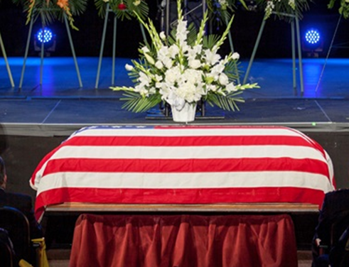
Safety Considerations
Emotionally charged
The unknown
Unpredictable Behavior (V/S)
Loss of control by abuser
Facing punishment
Reluctant victim
Children
Murder/Suicide
Suicide by cop
Always take a cover unit!

Slide 40
Legal Mandates
1. Offer medical attention at the scene – PC 13701(c)
2. Offer an EPO to the victim – FC 6275
3. Standby and provide safe passage from scene – PC 13701(c)
4.Victim has a right to confidentiality – GC 6254(f)
5. Advise the victim the suspect may be released from custody at any time – PC 13701(c)
6. Provide verbal and written Marsy’s Rights – PC 679.05
7. Advise the DV victim that they have the right to a domestic violence counselor at follow up law enforcement interviews – PC 679.05

Slide 41
Legal Mandates
8. A report must be written when the victim in a DV relationship is in fear of imminent serious bodily injury – PC 13730(a) and PC 13700(a)
9. Victim is entitled to a free copy of their report – FC 6228
10. Document if alleged abuser show signs of being under the influence of alcohol or a controlled substance – PC 13730(c)
11. Document if there was previous response to location of DV involving either party – PC 13730(c)
12. If you asked parties at a DV incident about guns in the home, their response must be documented in your report – PC 13730(c)(3)
13. If you are at a DV scene, unserved RO’s must be served on the Restrained Party if present – PC 13710(c)
14. In DV strangulation assaults, the investigating officer shall inform the victim that strangulation may cause internal injuries and encourage the victim to seek medical attention. – PC 13701(I)

Slide 42
Contact
Detective Tyler Mazzocco
Domestic Violence Detective
760-931-2144
Tyler. Mazzocco@Carlsbadca.gov

